Slide 1

Caro King
Member
Nguyen Hong Phong Phu
Nguyen Tan Trung
Han Trung Kien
Pham Huu Thang

Slide 2
Assignment
Pham Huu Thang | Login | 100%
Han Trung Kien | Home and navbar | 100%
Nguyen Hoang Phong Phu | Game room | 100%
Nguyen Tan Trung | Data linking and lobby | 100%
Members
Tasks
Completition Rate

Slide 3
Contents
01. Introduction
02. Technologies
03. Development Process
04. Experience

Slide 4
Timeline
Research and working on multiplayer
Got the assignment
Start doing Back-end
5/2
2/1
3/1
4/2
2021
2021
2021
Link Back-end to Front-end
Bug fix and presentation
Sketching Layout.
Design Front-end

Slide 5
INTRODUCTRION
01

Slide 6
Introduction
Caro King
User friendly
Connect people together
Multiplayer

Slide 7
02
TECHNOLOGIES

Slide 8




Main framework
Angular
Technology
Socket IO

Slide 9
03
DEVELOPMENT PROCESS

Slide 10
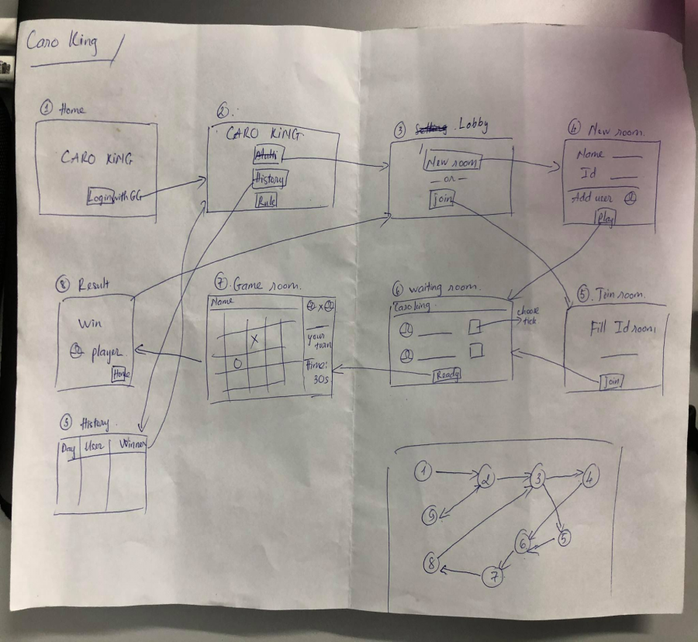
Prototypes

Slide 11
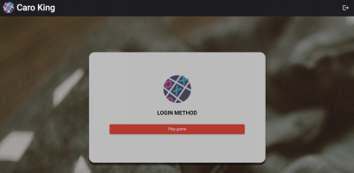
Caro King

Slide 12
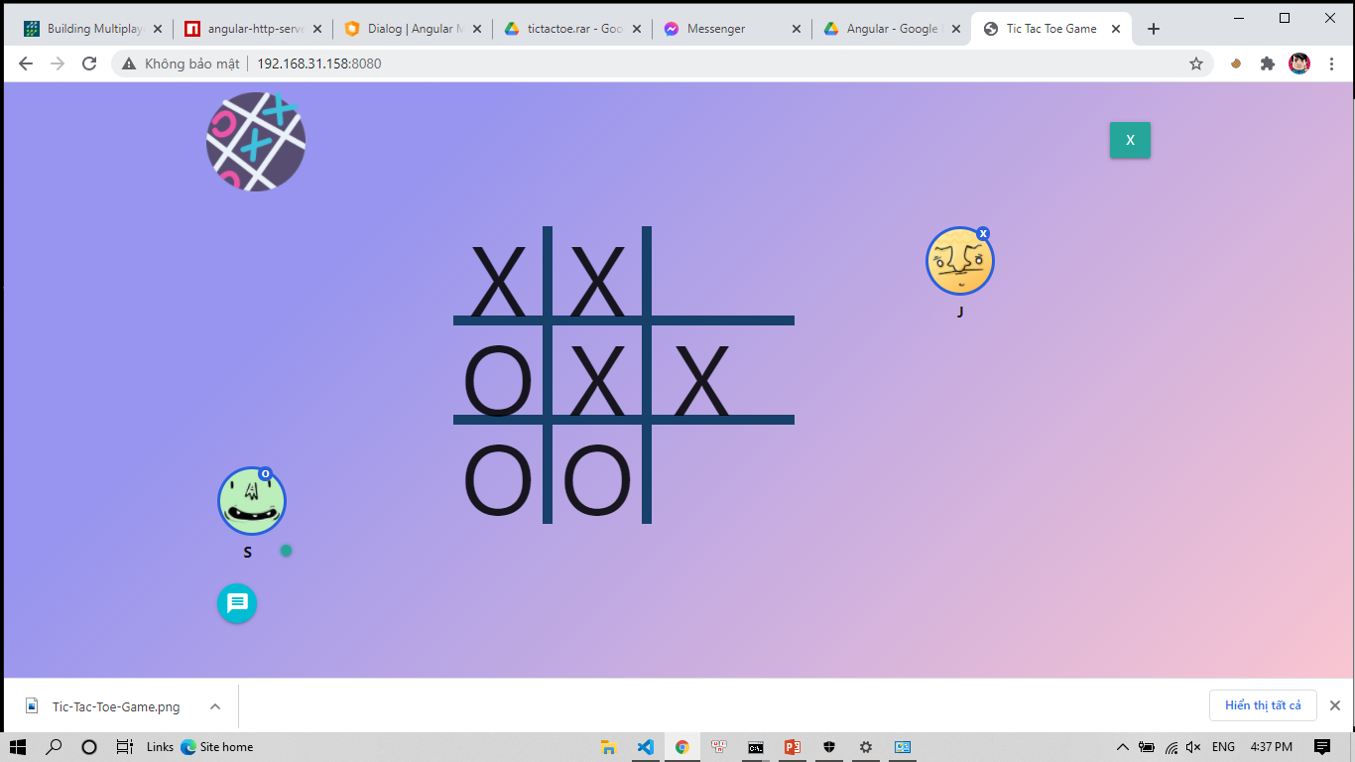
Caro King

Slide 13


Features
Create room
Find room
Map choosing
Login with Google
Ingame chatting
Multiplayer

Slide 14
Current Limitations
Game record
Map choosing
Create room
Find room
Background customization

Slide 15

Demo

Slide 16
04
EXPERIENCE

Slide 17

EXPERIENCE
Teamwork with new team
Back-end Data Linking
Learning Socket IO
Using Framework
Usage of Angular Material

Slide 18
Thank you for listening
www.itsstraining.edu.vn

